Slide 1

eigr.io – A Serverless Runtime on the BEAM
ACM SIGPLAN, ICFP Erlang Workshop 2021 Marcel Lanz, August 26th 2021

Slide 2

Agenda
eigr.io – A Serverless Runtime on the BEAM
eigr.io – Eigr Functions
A Serverless Runtime on the BEAM
Highlights
Inversion of State, a Protocol, being Polyglot
Current State & Challenges
ACM SIGPLAN, ICFP Erlang Workshop 2021

Slide 3
Eigr Functions
eigr.io – A Serverless Runtime on the BEAM
Serverless Runtime
that enables General Purpose Applications to be built
Open Source Project
Bases on a concept of another open source project
Inactive at the moment
Implementation of a Cloudstate Service Proxy
Based on a Protocol
Polyglot SDKs
ACM SIGPLAN, ICFP Erlang Workshop 2021

Slide 4
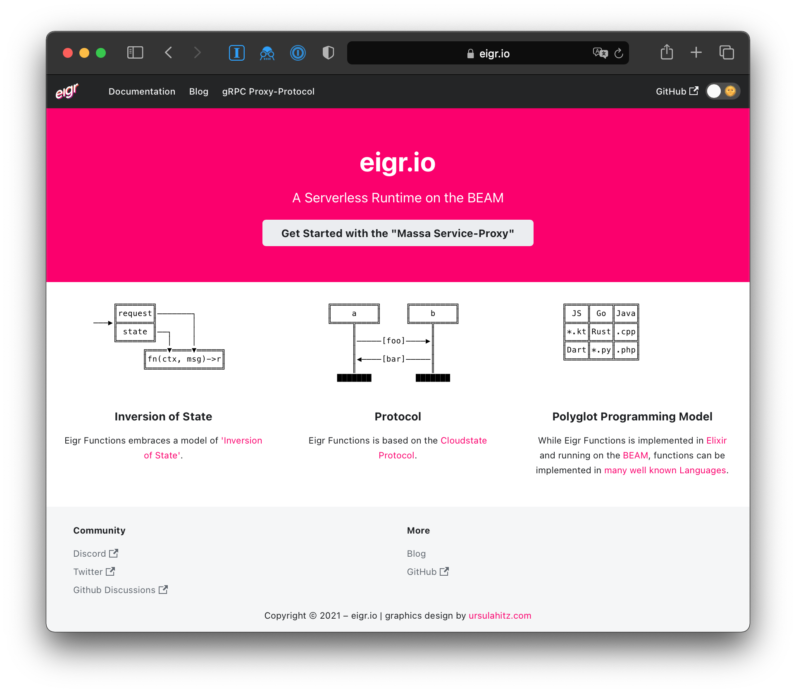
Highlights
eigr.io – A Serverless Runtime on the BEAM
A Service Proxy
with managed State
Cloud Native deployment (k8s)
A Protocol
gRPC based, with a spec and a TCK
Polyglot Programming Model
SDKs in JavaScript, Python, Kotlin, Java, Go, C#, Dart, Elixir, …
… and it runs on the BEAM :)
ACM SIGPLAN, ICFP Erlang Workshop 2021

Slide 5
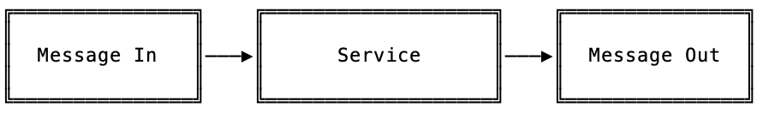
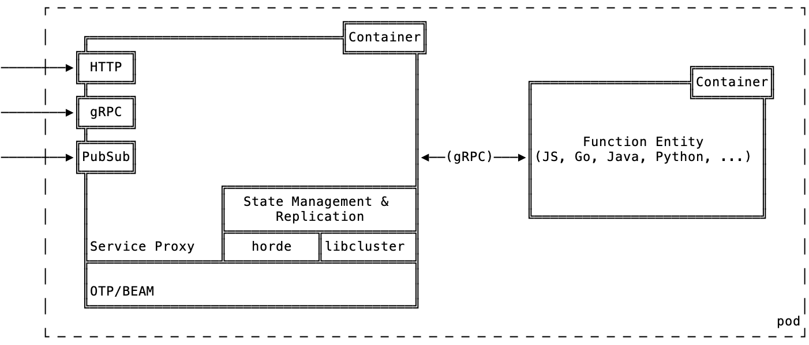
Service Proxy
eigr.io – A Serverless Runtime on the BEAM
“Message IN, Message OUT”
eigr/massa
Implemented in Elixir
Kubernetes Operator
Sidecar Proxy
ACM SIGPLAN, ICFP Erlang Workshop 2021

Slide 6
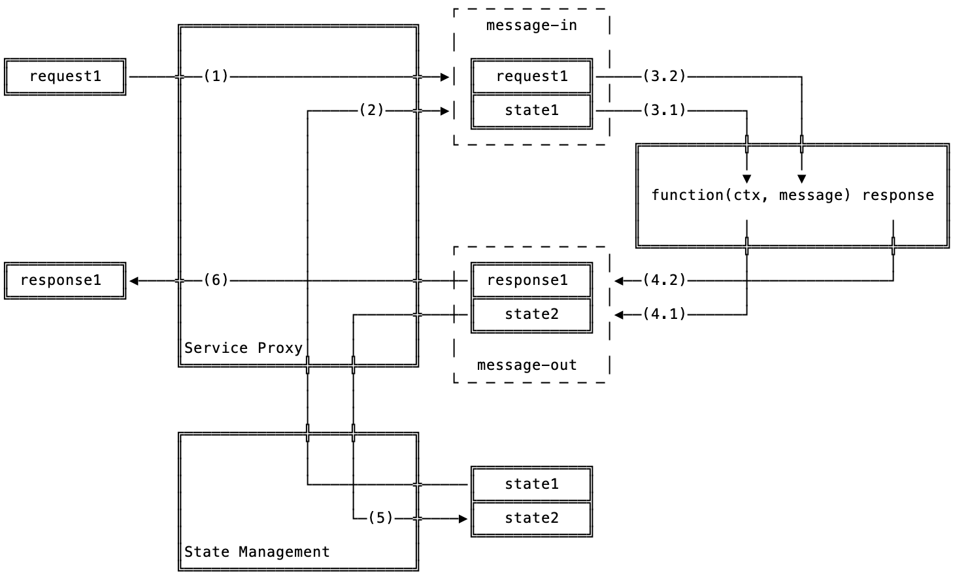
Inversion of State
eigr.io – A Serverless Runtime on the BEAM
FaaS is usually stateless
State is brought to the function.
State Model to choose
Action
Eventsourcing
CRDTs
Value Entity (CRUD)
ACM SIGPLAN, ICFP Erlang Workshop 2021

Slide 7
A Protocol to use
eigr.io – A Serverless Runtime on the BEAM
Eigr Functions implements the Cloudstate Protocol
Abstracts State
defines these State Models in *.proto files
gRPC based
based on HTTP/2
enables Streaming
Protocol spec defined in *.proto (protocol buffer)
Technology Compatibility Kit (TCK)
ensures proxy and SDKs compatiblity
ACM SIGPLAN, ICFP Erlang Workshop 2021

Slide 8
Polyglot Programming Model
eigr.io – A Serverless Runtime on the BEAM
SDK support for all gRPC enabled languages possible
gRPC compiler available
JavaScript, Java and Go with 100% TCK coverage
Python, Kotlin, Java, Go, C#, Dart, Elixir with at least Support for Eventsourcing
ACM SIGPLAN, ICFP Erlang Workshop 2021

Slide 9
Current State & Challenges
eigr.io – A Serverless Runtime on the BEAM
Service Proxy in Elixir (eigr/massa)
gRPC Reflection ☑️
Discovery and Action Protocol ☑️
Next Challenges
Implement State Models
CRDT, Eventsourcing, CRUD
Enhance and Improve SDKs
Focus on JS, Java, Python and Go
Enhance the TCK
ACM SIGPLAN, ICFP Erlang Workshop 2021

Slide 10
Thanks!
eigr.io
github.com/eigr
@eigr_io
❤️ 🙌 thanks to all contributors and supporters: Adriano Santos, Alain-Michel Chomnoue Nghemning, GratefulTony, Guy Youansi, Weslei Juan Moser Pereira, Jonathan Nagy, Peter Vlugter, Vladimir Korenev, Ursula Hitz, Viktor Klang, Cloudstate.io and many more…
ACM SIGPLAN, ICFP Erlang Workshop 2021 Marcel Lanz, August 26th 2021

